Slide 1


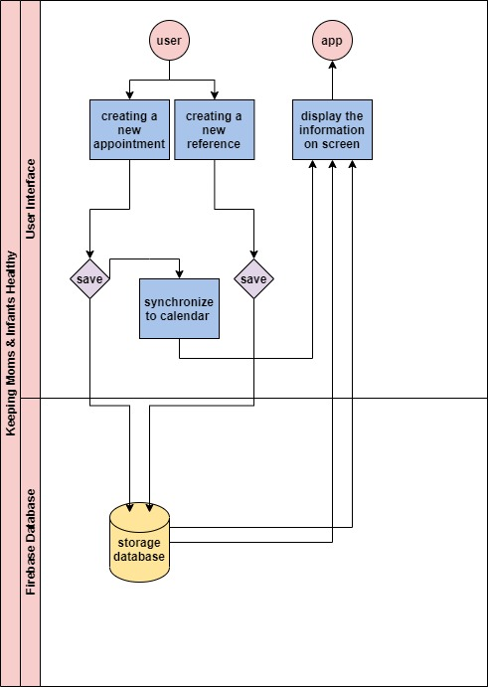
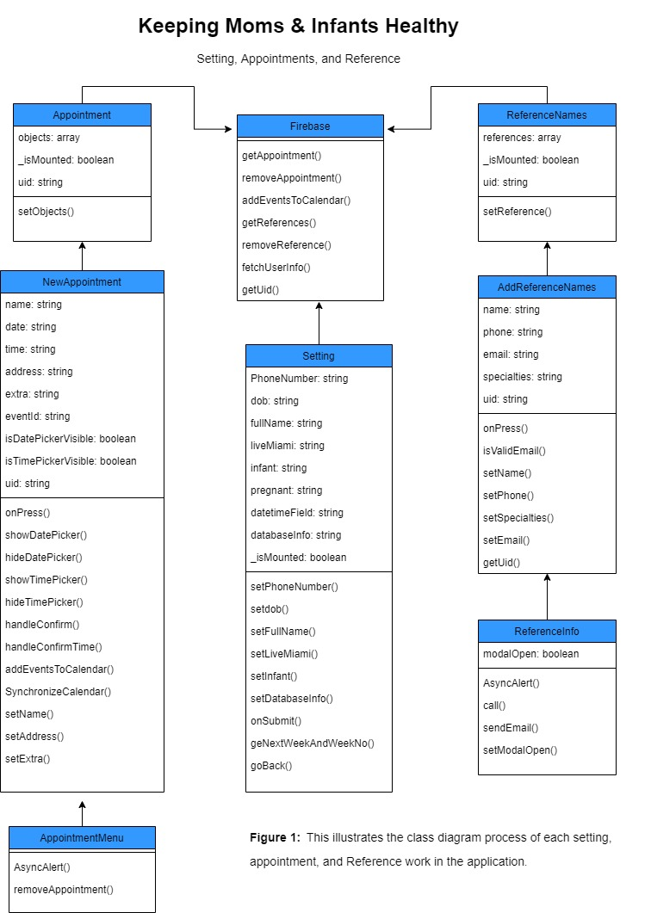
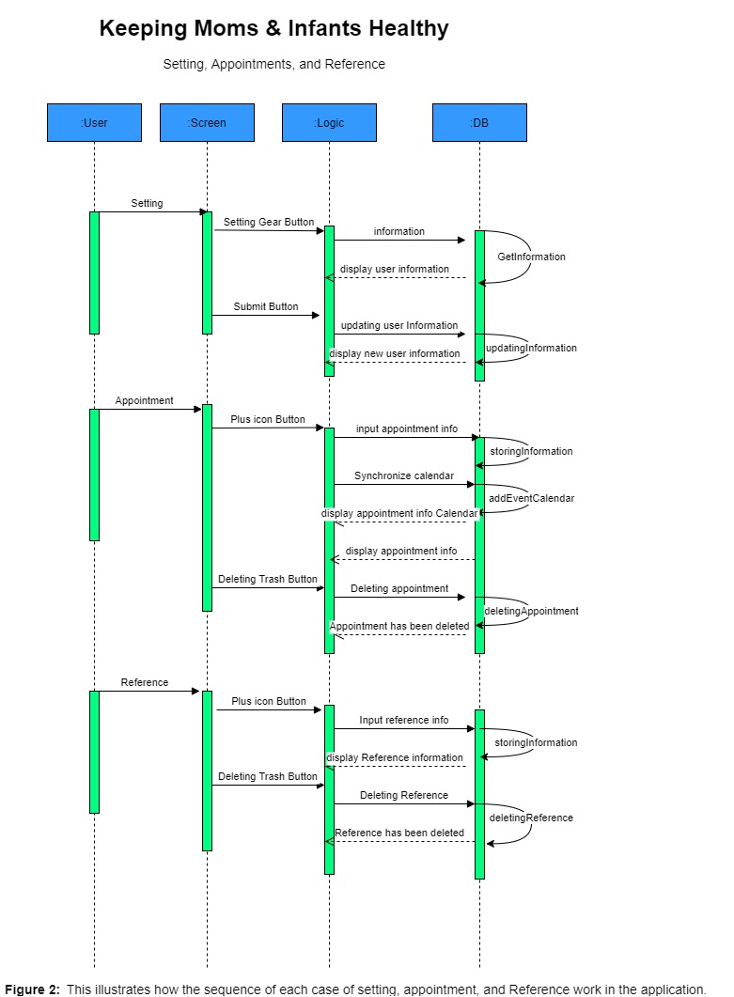
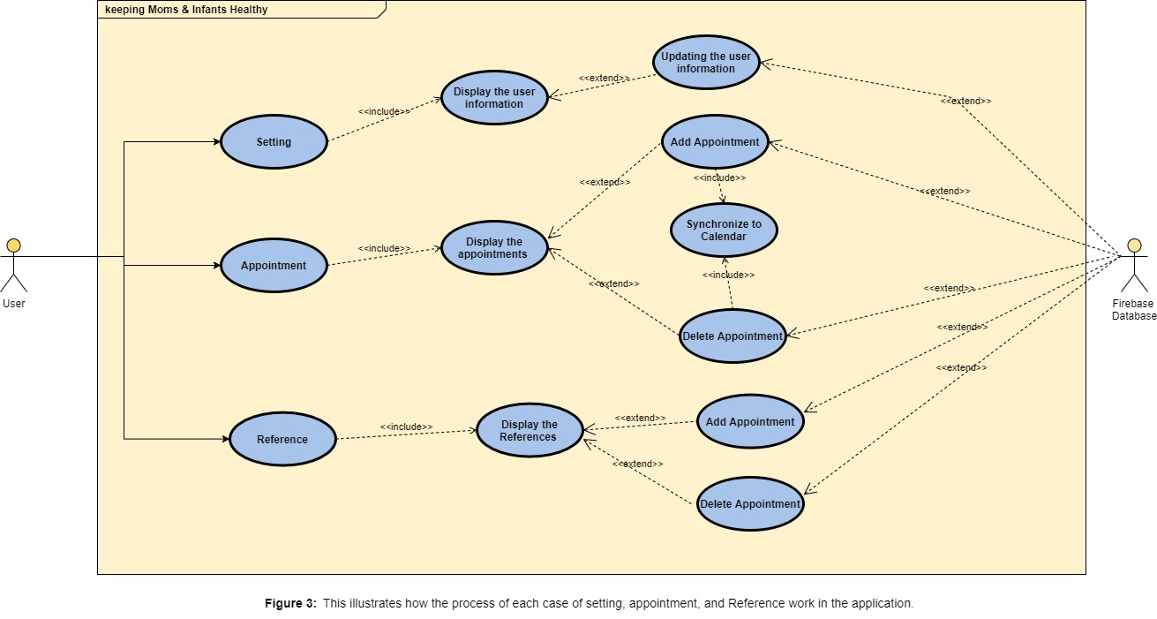





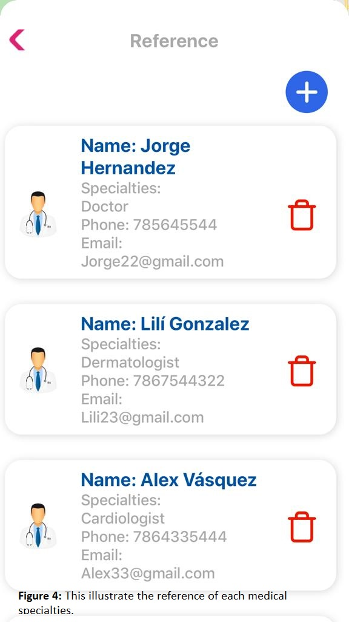
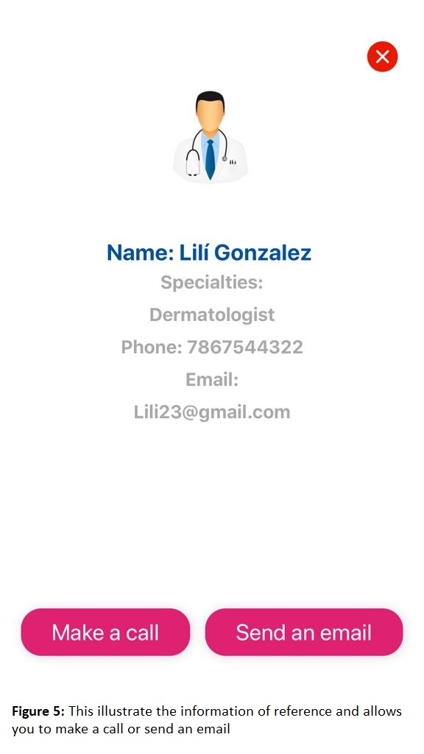
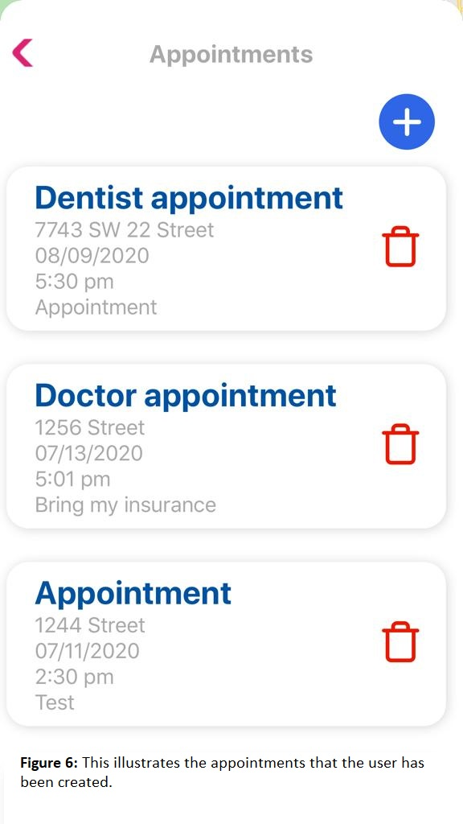
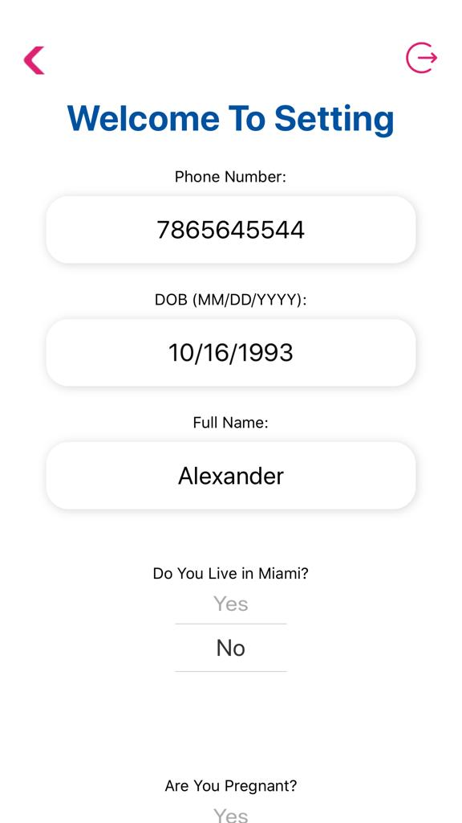
School of Computing & Information Sciences
Summer 2020 Senior Design Project
Keeping Moms & Infants Healthy V3
Students: Noe Velasquez
Product Owner: Dr. Jean Hannan
Instructor: Dr. Masoud Sadjadi, Florida International University
Problem
Current System
Requirements
Helping low-income mothers obtain the necessary resources on how to reference their medical specialties. As well, finding an easy way to organize and make appointments for their medical specialties. Every mother should have access to the necessary resources to care for their baby at no cost.
The current system was very limited didn’t provide many features.
It did not contain a setting feature where the user allows make changes/updates to their personal information.
There was no information about the shelter, learn, and resources.
There were no appointments and reference features available.
Adding a Setting feature, a simple way to make changes/updates to the user’s information.
To have resources available.
Schedule an appointment for your doctor or any medical specialties plus a notification reminder.
References your doctor or any medical specialties.
System Design
Object Design
Implementation
Verification
Screenshots
Summary
The third version of the "Keeping Moms and Infants Healthy" app has been improved with new features added. This version allows you to make appointments and a simple way to schedule your appointments, it will also be synchronized to your calendar. In addition, it allows you to references your doctors and any medical specialties that provides the option to call and email them. With these new features added the app makes it easy to access, organize, and contact your medical specialties. Every mother should have access to the necessary resources to care for their baby at no cost.
Case ID | Appointment
Purpose | Schedule Appointments
Preconditions | Users must provide the information for the appointments such as name of appointment, date, time, extra information.
Expected results | The user is able to schedule appointment for any medical purpose plus it will synchronized to default calendar.
Case ID | Reference
Purpose | Reference your Doctor or any medical specialties
Preconditions | Users must provide the information of the reference such as name of reference, medical specialties, phone, email.
Expected results | The user is able to reference any medical specialties plus it allows them to make a call or email them.
Case ID | Setting
Purpose | To update or make changes to the user information
Preconditions | Users must make any change to any fields provide by the setting section and click save.
Expected results | The user is able to update or change their personal information.
Acknowledgement
The material presented in this poster is based upon the work supported by Product Owner Dr. Jean Hanna. We/I thank Dr. Masoud Sadjadi for assistance, cooperation and mentorship that I received throughout this process. I also want thank my partners Amin, Gabriel, Mike for help and support throughout the project.

